Slide 1
Q & A
In Linux, it is possible to interrupt a user process even it is running kernel functions.
Interrupt priority determines the order of service, with higher-priority interrupts being handled first, and nested interrupts allow one interrupt to preempt another if necessary.

Slide 2
Recap: Handling Hardware Events
How CPUs work with slower hardware devices
Polling: Periodically, the kernel checks hardware status and responds accordingly.
Interrupt: Let the hardware to signal to the kernel.
What causes interrupts:
Interrupt (Asynchronous, Hardware Interrupts): Hardware devices physically produce electronic signals, which are directed into input pins on an interrupt controller.
Motherboard
Local APIC
Local APIC
CPU
CPU
Chipset
DRAM
Northbridge (Memory Controller Hub)
GPU
Southbridge (I/O Controller Hub)
Keyboard
Interrupt Controller (I/O APIC)
HDD
PCIE SSD
Note: After 2019, all northbridge functions
had been integrated into CPU!!
Ref1: https://zhuanlan.zhihu.com/p/313725721
Ref2: https://en.wikipedia.org/wiki/Northbridge_(computing)

Slide 3
Recap: Handling Hardware Events (Count.)
How CPUs work with slower hardware devices
Polling: Periodically, the kernel checks hardware status and responds accordingly.
Interrupt: Let the hardware to signal to the kernel.
What causes interrupts:
Interrupt (Asynchronous, Hardware Interrupts): Hardware devices physically produce electronic signals, which are directed into input pins on an interrupt controller (e.g., keyboard, disk).
Exceptions (Synchronous, Software Interrupts): Exceptions are produced by the processor while executing instructions either in response to a programming error (e.g., divide by zero) or abnormal condition (e.g., call a system call or a page fault).

Slide 4
Recap: How an Interrupt Works
How an interrupt works:
Hardware devices send out an interrupt signal.
The CPU stops current execution.
The interrupt controller sends INT # to the CPU.
CPU accesses the Interrupt Vector Table by INT # * 4
The CPU runs the interrupt service routine to handle the interrupt.
ISR=Interrupt Service Routine
Motherboard
INT 0x81
Local APIC
CPU
CS‘:IP’
0x81 * 4 = 0x324
Code of ISR
0x0
0x4
0x324
CS‘:IP’
ISR 0
Vec
ISR 81
Vec
ISR 255
Vec
ISR 81
Memory
ISR 1
Vec
…
…
4B (CS:IP)
Timer
Southbridge (I/O Controller Hub)
Interrupt
IRQ0
Keyboard
Interrupt Controller
IRQ1
IRQ 1 → INT 0x81 (Translates to IVN)
…
IRQ2
IRQ8
Ref1: Fan, Xiaocong. Real-time embedded systems: design principles and engineering practices. Newnes, 2015.
Notes:
Actually, there is no specific name for the table inside interrupt controller

Slide 5
Interrupt Handler
Interrupt Service Routine (ISR) or Interrupt Handler: The function the kernel runs in response to a specific interrupt.
It is part of a device driver (the kernel code manages the device)
Challenge: ISR is non-blockable (Cannot Sleep). The handler shall run quickly, to resume execution of the interrupted code as soon as possible.
Split the ISR into two parts (Top Halves + Bottom Halves):
Top Halves: Run immediately upon receipt of the interrupt and performs only the work that is time-critical.
Bottom Halves: Work that can be performed later is deferred until the bottom half.
Example:
A network card received a packet, triggers a network device interrupt. (Interrupt low-priority interrupt, such as timer interrupt)
Top Halves acknowledges the interrupt and performs quick actions (e.g., reading the NIC status, marking the buffer as ready).
Bottom Halves move the packet from the buffer in the network card to host memory.

Slide 6


L3: Memory Management
Chun-Feng Wu (吳俊峯)
Assistant Professor, National Yang Ming Chiao Tung University
cfwu417@cs.nycu.edu.tw
https://cfwu417.github.io
Notes:
Good Morning, My name is Chun-Feng Wu. In this presentation, I will briefly introduce myself and share some key idea of my researches.
Intensive data movement is one of the critical issue when Von-Neumann machines enter the big data era.
To deal with this issue, my research is to enable a fast, large and device-friendly next-generation computing system.

Slide 7
Agenda
Physical Memory Management
Basic Concept: Page vs (Page) Frame
Manage Kernel Physical Address (Page, Zone, Node)
Memory Allocation: First Fit, Best Fit, Worst Fit, Buddy, Slab Allocator
Virtual Memory Management
Virtual Memory Area (VMA)
How CPU Walks Page Table
Advance Research Topics

Slide 8
Recall: Basic Concepts of Memory Management
Page Frame: Partition physical address space to chunks with the same size
Page (Virtual): Partition virtual address space to chunks with the same size
Physical vs Virtual Addresses
Physical: The location where the data actually stored on the device. (Page Frame)
Virtual: The location where the programmers think the data is. (Page)

Slide 9
Recall: Basic Concepts of Memory Management
Page Frame: Partition physical address space to chunks with the same size
Page (Virtual): Partition virtual address space to chunks with the same size
Kernel manages all page frames and maintains page tables.
How to manage each page frame
How to do the allocation
CPU
P1 calls malloc()
Kernel allocates page frames
Kernel updates page tables
1. How the kernel manages (allocates or frees) physical memory (page frame)
Page Frame
Page Frame
Page Frame
Page Frame
Page Frame
Page Frame
Page Frame
Page Frame
Page Frame
Page Frame
4KB
Page
Table
Allocated
……
……
VA -> PA
Kernel Address Space (Low Mem)
User Address Space
Physical Address Space (e.g., DRAM)

Slide 10
Recall: Basic Concepts of Memory Management
Page Frame: Partition physical address space to chunks with the same size
Page (Virtual): Partition virtual address space to chunks with the same size
Kernel manages all page frames and maintains page tables.
Virtual Memory Management: Let all processes share the same physical address space via page tables. (Each process has their own page table.)
CPU
VA
Not in TLB
TLB
MMU
2. How the kernel manages process address space (page)
VA’ -> PA’
1
PA
2
Page
Table
Page Frame
Page Frame
Page Frame
Page Frame
Page Frame
Page Frame
Page Frame
Page Frame
Page Frame
Page Frame
Page
Data
……
……
VA -> PA
Assume only one-level (4-level Actually)
4KB
Physical Address Space (e.g., DRAM)

Slide 11
Manage Physical Address (Page Frame)
Although the processor’s smallest addressable unit is a byte, the memory management unit (MMU) typically deals in pages (e.g., 4KB or 8KB).
Each page frame is managed by a struct page structure (struct page is associated with physical pages, not virtual pages)
Overhead: 40B for each struct page, 4KB for each page frame, 4GB DRAM Require Only 40MB
struct page {
unsigned long flags;
atomic_t _count;
atomic_t _mapcount;
unsigned long private;
struct address_space *mapping;
pgoff_t index;
struct list_head lru;
Void *virtual;
};
→ status, e.g., dirty, lock
→ How many references.
→ If the page is used by page cache
→ Offset of a file or a swap file.
→ For the page replacement policy
→ Page’s virtual address

Slide 12
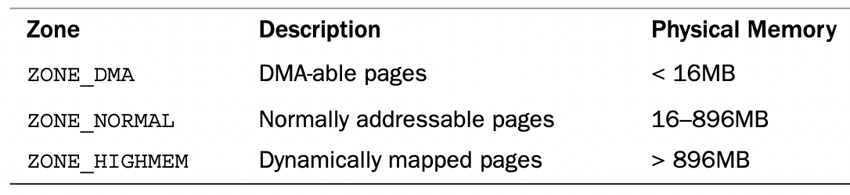
Manage Kernel Physical Address (Zone)
The kernel uses the zones to group pages of similar properties (or hardware characteristics), three primary zones below.
ZONE_NORMAL: The zone contains normal, regularly mapped, pages.
ZONE_DMA: Page frames that can undergo DMA (Direct Memory Access).
ZONE_HIGHMEM: Some page frames are not permanently mapped into the kernel address space.
Assume Kernel Space has only 1GB
Zones on x86-32
(Notice: x86-64 has no ZONE_HIGHMEM, 64bits address space is pretty large)
Ref: Gorman, Mel. Understanding the Linux virtual memory manager. Upper Saddle River: Prentice Hall, 2004

Slide 13
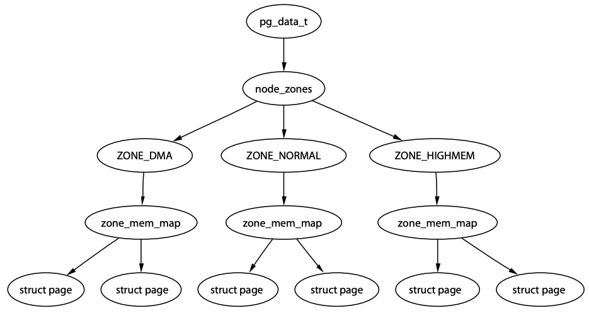
Manage Kernel Physical Address (Nodes)
Uniform Memory Access vs Non-Uniform Memory Access
Nodes
Maintains a data structure (pg_data_t) for each NUMA node.
Allocate memory from the node closest to the running CPU.
Granularity: Nodes → Zones → Page Frames
CPU
CPU
Local Access
Remote Access (~2x Slower)
Why NUMA?
Fast local access
Higher bandwidth
Easy to scale out
Memory
Controller
CPU
CPU
DRAM
Memory
Controller
Memory
Controller
DRAM
DRAM
DRAM
A memory node (or bank)
Ref: Gorman, Mel. Understanding the Linux virtual memory manager. Upper Saddle River: Prentice Hall, 2004

Slide 14
Basic Concepts of Memory Allocation
Initially, all memory is available and is considered as a large block of hole.
When a process needs memory, the system searches the set for a hole that is large enough for this process.
First Fit: Search and allocate the first hole that is big enough. (Waste Size)
Best Fit: Search all holes and allocate the smallest hole, which is big enough. (Waste Time)
Worst Fit: Search all holes and allocate the largest hole. (Waste Size & Time)
Fragmentation (Low Utilization):
External Fragmentation: Enough total memory space to satisfy a request but the available spaces are not contiguous. (Paging can solve this!)
Internal Fragmentation: Occurs when systems split the continuous space into continuous chunks (e.g., page)
P1
P2
P3

Slide 15
Linux Page Allocation
alloc_pages() function allocates a single page or 2^{order} pages and returns pointer to the first page’s page struct. (Buddy System)
For more general byte-sized allocations, the kernel provides kmalloc().
User-space Memory Allocation
Kernel-space Memory Allocation
Big Size
Small Size
malloc() – C Library
vmalloc()
kmalloc()
Request Size
(Large for MMap)
Brk()
Mmap()
Slab Layer
If no slabs
Low-level Memory Allocator
(alloc_pages() – Buddy System)
Page Granularity
Physical DRAM
Ref: Advanced Operating Systems, Shinpei Kato, 2018 https://www.pf.is.s.u-tokyo.ac.jp/wp-content/uploads/2018/10/AdvancedOperatingSystems3.pdf

Slide 16
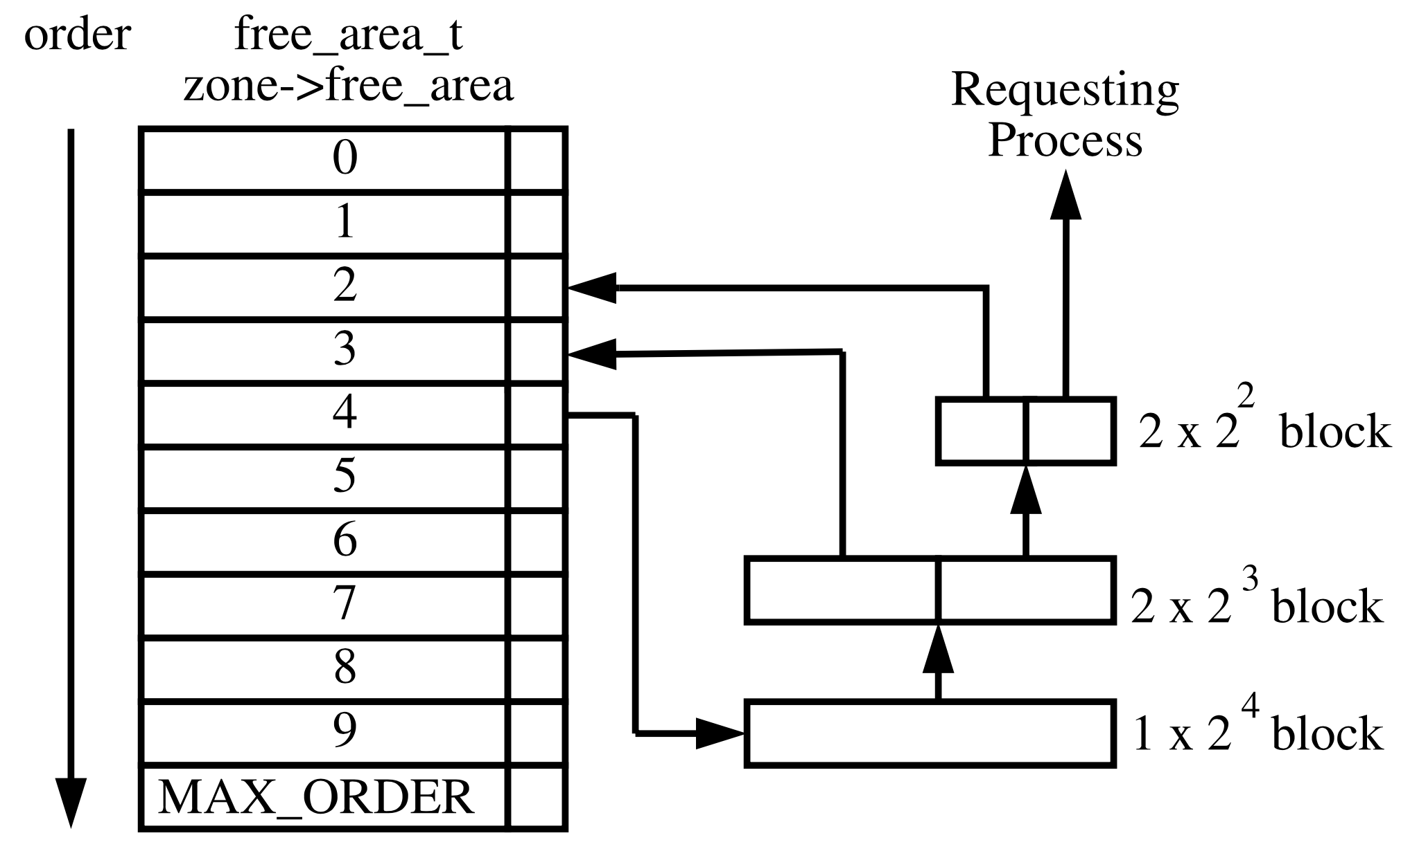
Linux Page Allocation -- Buddy System
alloc_pages function allocates a single page or 2^{order} contiguous physical pages and returns pointer to the first page’s page struct. (Buddy System)
If a process requests a 2² block. But there is no free pages in order 2 and 3.
Ref: Gorman, Mel. Understanding the Linux virtual memory manager. Upper Saddle River: Prentice Hall, 2004

Slide 17
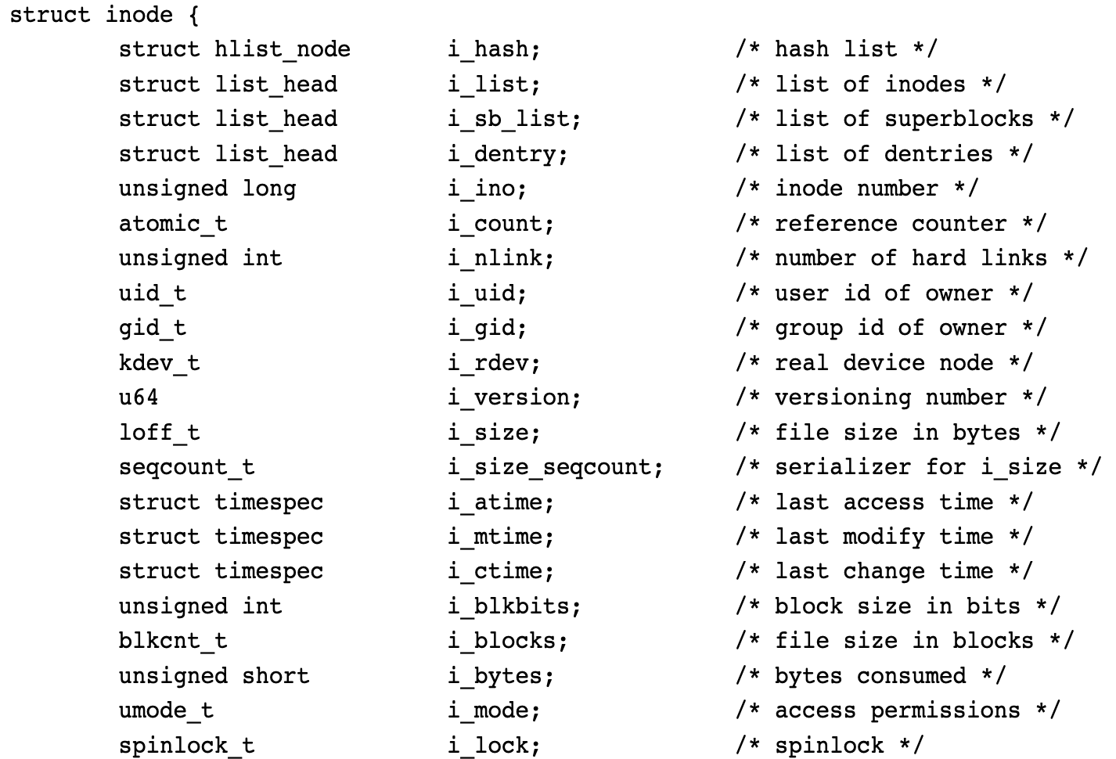
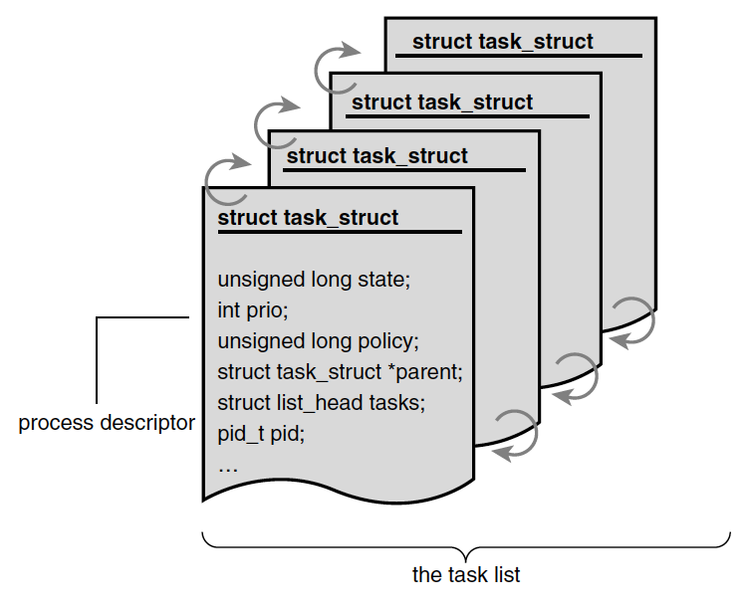
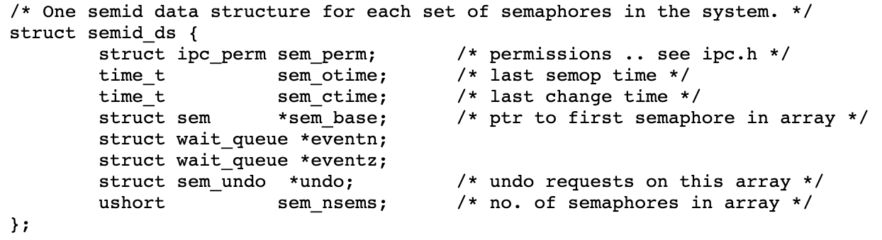
Why Slab Layer?
Grouping kernel objects (i.e., data structure) into slab caches. Pre-allocating memory pages in slabs leading to faster memory allocation.
When the data structure is no longer needed, it is returned to the free list instead of deallocated.
Example: process descriptors (a free list of task_struct), file objects (inode), semaphore

Slide 18
Why Slab Layer? (Count.)
Grouping kernel objects (i.e., data structure) into slab caches. Pre-allocating memory pages in slabs leading to faster memory allocation.
When the data structure is no longer needed, it is returned to the free list instead of deallocated.
Example: process descriptors (a free list of task_struct), file objects (inode), semaphore
The slab layer acts as a generic data structure-caching layer
Frequently used data structures tend to be allocated and freed often, so cache them.
Frequent allocation and deallocation can result in memory fragmentation.
Can be made per-processor, so that no locks are required for allocation and deallocation.
Can be NUMA-aware

Slide 19
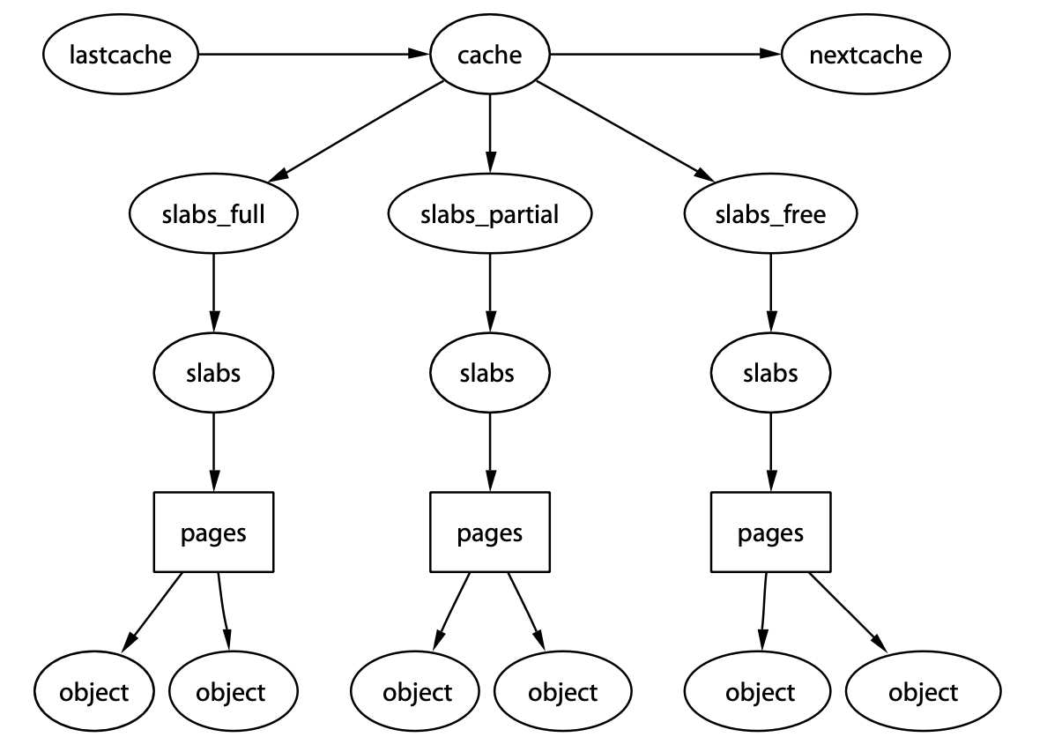
How Slab Layer Works
One cache per object (e.g., task_struct, inode, semaphore) type
Main Idea: Avoid from allocating and freeing physical address as frequent as possible.
Structure: Cache → Slab → Page
Full Lists
Partial Lists
Empty Lists
Contiguous Memory
Slab 1
Slab 2
Slab 3
Page
Page
Page
Used
task_struct
Unused
task_struct
Unused
task_struct
Used
task_struct
Unused
task_struct
Unused
task_struct
Page
Page
Page
Used
task_struct
Used
task_struct
Unused
task_struct
Used
task_struct
Used
task_struct
Unused
task_struct
On Full Lists
On Partial Lists
On Empty Lists
Ref: Gorman, Mel. Understanding the Linux virtual memory manager. Upper Saddle River: Prentice Hall, 2004
Notes:
The slab layer divides different objects into groups called caches, each of which stores a different type of object.
Full Lists: All objects on a slab marked as used
Partial Lists: Slab comprises both used and free objects
Empty Lists: All objects on a slab marked as free

Slide 20
How Slab Layer Works (Count.)
Main Idea: Avoid from allocating and freeing physical address as frequent as possible.
Structure: Cache → Slab → Page
Run Allocation: Only when there does not exist any partial or empty slabs in each cache.
Run Free: Only when available memory grows low.
Ref: Gorman, Mel. Understanding the Linux virtual memory manager. Upper Saddle River: Prentice Hall, 2004
Notes:
The slab layer divides different objects into groups called caches, each of which stores a different type of object.
On the same system and with the same kernel configuration, the size of the slab cache allocated for the same object should typically remain consistent. Slab caches are created based on the specific requirements of the objects they manage, and once configured, they maintain a consistent size.

Slide 21
Linux Page Allocation
Two common libraries to allocate kernel memory: kmalloc() and vmalloc().
User-space Memory Allocation
Kernel-space Memory Allocation
Big Size
Small Size
malloc() – C Library
vmalloc()
kmalloc()
Request Size
(Large for MMap)
Brk()
Mmap()
Slab Layer
If no slabs
Low-level Memory Allocator
(alloc_pages() – Buddy System)
Page Granularity
Physical DRAM
Ref: Advanced Operating Systems, Shinpei Kato, 2018 https://www.pf.is.s.u-tokyo.ac.jp/wp-content/uploads/2018/10/AdvancedOperatingSystems3.pdf

Slide 22
kmalloc() vs vmalloc()
The kmalloc() function obtains kernel memory in byte-sized chunks.
Note, malloc() in C library is for allocating user space memory.
If we need a whole 4KB page, alloc_pages() in prior slides fits better.
Return a pointer points to a block of memory that is at least the requested size.
The vmalloc() function allocates memory that is only virtually contiguous.
Requires page tables to maintain the mapping between virtual and physical addresses.
Allocate virtual memory initially, and then map to physical memory on-demand
Regarding performance, memory allocation inside kernel usually uses kmalloc().
If systems can get enough contiguous physical addresses all the time, then nearly no address translation overhead (1:1 direct mapping), like kmalloc()!
vmalloc() is used only when systems require large regions of memory.
Notes:
When you use vmalloc() in the Linux kernel, it initially allocates a contiguous region of virtual memory, but it doesn't immediately allocate corresponding physical memory. The physical memory allocation occurs on-demand, as pages within the virtual memory region are accessed and written to.

Slide 23
High Memory
On 32-bit system, kernel only has 1GB virtual memory. What if systems have 8GB memory space?
Sol: Kernel address space reserves a 128MB dynamic mapping area, called High Memory (e.g., 896MB ~ 1GB) .
High Memory: High memory is memory that is not permanently mapped into the kernel's address space. (Temporarily Mapping)
Usage: file caching, DMA & networking buffers,
High memory is a hack. We don't need it on 64-bit systems.
Direct Mapping: PA = VA + Offset
4GB
0GB
ZONE_HIGHMEM
vmalloc()
Kernel Code/Data
3.896
GB
Kernel Virtual
Address Space (1G)
ZONE_NORMAL
kmalloc()
3.16
GB
896MB
HIGHMEM
3GB
ZONE_DMA
4GB
Ref: https://www.796t.com/content/1544392447.html
Ref: https://www.quora.com/Why-is-there-ZONE_HIGHMEM-in-the-x86-32-Linux-kernel-but-not-in-the-x86-64-kernel
Ref: https://www.quora.com/In-reference-to-Linux-Kernel-what-is-the-difference-between-high-memory-and-normal-memory
Virtual Address Space
Physical Address Space
Notes:
High memory is typically used for situations where physical memory addresses exceed the limitations of the CPU's address bus.
File Caching: High memory can be used for caching file data that doesn't need to be in the lower, directly accessible physical memory. When data is read from disk, it can be cached in high memory, making efficient use of the available RAM for caching purposes.
User Process Address Space: High memory can be used for mapping parts of user processes' address space when it is necessary to allocate memory that doesn't need to be directly accessible with the CPU's 32-bit address space.
DMA and I/O Buffers: High memory can be used for Direct Memory Access (DMA) buffers and I/O buffers that are not directly accessible by the CPU. This is important for certain device drivers and hardware devices that require DMA to transfer data directly between device and RAM.
Large Kernel Data Structures: Some kernel data structures, like those used for large networking buffers or certain types of kernel caches, may be allocated in high memory to avoid fragmentation in lower memory areas.
Shared Memory: High memory can be used for shared memory segments where multiple processes need to share a common memory area that is larger than what can be accommodated in the lower memory.

Slide 24
Process Address Space (Virtual Address)
Notes:
Good Morning, My name is Chun-Feng Wu. In this presentation, I will briefly introduce myself and share some key idea of my researches.
Intensive data movement is one of the critical issue when Von-Neumann machines enter the big data era.
To deal with this issue, my research is to enable a fast, large and device-friendly next-generation computing system.

Slide 25
Virtual Address Spaces
On Linux, each process is given a unique and flat 32- or 64-bit address space.
Unique: Processes can have different data at the same address in their own address space. (Note: Processes can also share address space, like threads)
Flat: Modern Linux system does not use segmentation.
Memory address is a particular value identifying a specific byte in a process’s address space (32-bit address space: 0 to 2³² or 4294967295)
Not every address is legal, intervals of legal addresses are memory areas.
Permission: readable, writeable, executable
Temporary Mapped
Kernel Virtual
Address Space (1G)
Kernel Code/Data
Process-Specific Data Structures (e.g., Page Table, kernel stack, mm_struct)
User Stack
Memory-Mapping for Shared Library
User Virtual
Address Space (3G)
Heap (via malloc())
BSS Section
(Uninitialized Global Variable)
Data Section
(Initialize Global Variable)
Text Section (e.g., Code)
Per Process Virtual Address Space On 32-bit System
Ref: Gorman, Mel. Understanding the Linux virtual memory manager. Upper Saddle River: Prentice Hall, 2004
User Mode

Slide 26
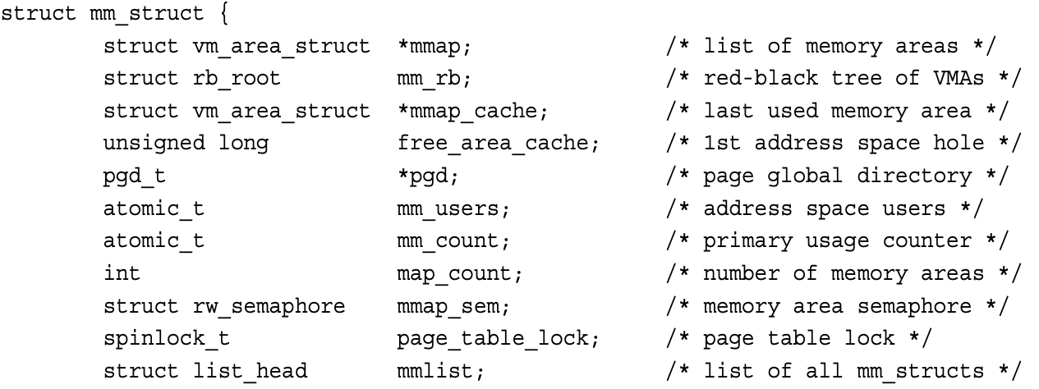
The Memory Descriptor
Memory descriptor (struct mm_struct) is a kernel data structure contains all information related to the process’s address space.
The memory descriptor associated with a given task is stored in the mm field of the task’s process descriptor.
Different data structures that contain the same thing:
all the memory areas in this address space.
Linked List → Fast for traversing, RB Tree → Fast for searching
2 proceses, 5 Threads:
mm_users = 6
mm_count = 7
Notes:
The key difference between the two is that mm_count tracks references to the memory map, which can come from multiple processes, threads, or sources, while mm_users specifically counts the number of users within the same process that are sharing the memory map. In many cases, mm_users will be equal to or less than mm_count because it's focused on the per-process reference count.

Slide 27
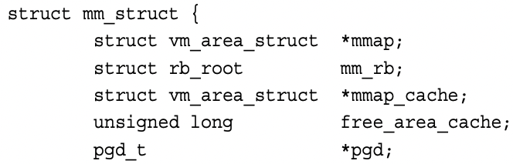
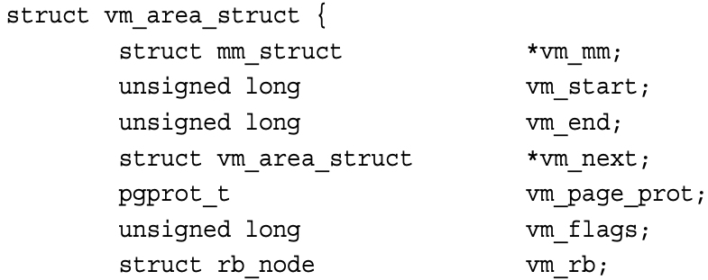
Virtual Memory Areas (VMA)
The memory area (or VMA) structure (vm_area_struct) describes a single memory area over a contiguous interval in a given virtual address space.
page
Process’s Virtual Address Space
VMA
VMA
VMA
vm_start
vm_end
vm_next
vm_next
vm_area_struct
mmap
mm_struct (Memory Descriptor)
Ref: https://manybutfinite.com/post/how-the-kernel-manages-your-memory/

Slide 28
Virtual Memory Areas (VMA) (Count.)
The memory area (or VMA) structure (vm_area_struct) describes a single memory area over a contiguous interval in a given virtual address space.
vm_area_struct
VM_READ | VM_WRITE | VM_GROWS_DOWN
Maintains a vm_area_struct for each file
struct file
/lib/libc.so
vm_area_struct
VM_READ | VM_EXEC
User Stack (Anonymous)
Chaining if heap is not contiguous
vm_area_struct
VM_READ | VM_WRITE
Memory-Mapping for Shared Library
Process’s Virtual Address Space
vm_area_struct
VM_READ | VM_WRITE
vm_start
vm_end
Heap (Anonymous)
vm_next
vm_next
vm_file
BSS Section
(Anonymous)
No File-Backed
vm_area_struct
VM_READ | VM_WRITE
vm_area_struct
struct file
/bin/execute
vm_next
Data Section
(File-backed)
mmap
vm_area_struct
VM_READ | VM_EXEC
vm_end
Text Section (e.g., Code)
vm_file
vm_start
mm_struct (Memory Descriptor)
mmap
task_struct
mm
mm_struct
Process’s Virtual Address Space
Ref: https://manybutfinite.com/post/how-the-kernel-manages-your-memory/

Slide 29
Virtual Memory Areas (VMA) (Count.)
The memory area (or VMA) structure (vm_area_struct) describes a single memory area over a contiguous interval in a given virtual address space.
Any two VMAs cannot overlap with each other. (Could call the find_VMA() to get the nearby VMAs. Checking the vm_end field.)
Merge two VMAs if they overlap with each others.
How to create or expand a VMA: do_mmap() is the function used to add an address interval to a process’s address space—whether that means expanding an existing memory area or creating a new one.
No file & offset → Anonymous
Initial Address for Finding Available Space
unsigned long do_mmap(struct file *file, unsigned long addr, unsigned long len, unsigned long prot, unsigned long flag, unsigned long offset)
Permission
File Offset

Slide 30
Page Tables
For systems with virtual memory management (or MMU), all virtual addresses shall be converted to physical addresses before being accessed.
Page Tables take the responsibility for address translations.
Each page table comprises a bunch of 8B page table entries (PTE) on 64-bit systems.
Size of page table is proportional to the memory size. (Larger Memory, More PTEs)
Linux uses multi-level page tables. (4-level for 64-bit systems)
Without optimization, CPU shall access memory for looking up a page table each time.
TLB is a hardware cache to keep the mapping between the VA/PA in the CPU.
CPU raises a page fault when a process accesses a memory page without proper preparations.
Minor Page Fault: Page is already in the memory but is not marked in the MMU as being loaded in memory. (e.g., malloc() allocates physical addresses once being touched)
Major Page Fault: Page is not in the memory. (May cause expensive I/O movement costs)

Slide 31
How the CPU Walks Page Tables
Let’s take 64-bit systems as an example. (Actually, only use 48bits)
The base address of PGD is maintained in CPU’s CR3 register.
CPU can walk automatically. Or kernel code can also walk it.
64bits Victim Virtual Address
+
pgd_offset()
+
pud_offset()
+
pmd_offset()
+
pte_offset()
64bit
Reserved
64bit
48bit
39bit
30bit
21bit
12bit
0bit
Unused Bits
(16bits)
PGD Offset
(9bits)
PUD Offset
(9bits)
PMD Offset
(9bits)
Page Table Offset (9bits)
Page Offset (12bits)
48bit
Physical
Address
Page Global Directory
(PGD) Table
Page Upper Directory
(PUD) Table
Page Middle Directory
(PMD) Table
Page Table (PT)
P
3
P
P
P
PGD Entry
+
PUD Entry
4
PMD Entry
PT Entry
12bit
+
PMD Entry
…
Control Bits (e.g., Present bit)
…
…
5
2
…
+
PT Entry
1
PGD Base Address
+
PGD Entry
PUD Entry
PMD Entry
…
PGD Entry
PUD Entry
PMD Entry
PT Entry
0bit

Slide 32
Why 4-Level Page Tables for 64-bit System
4KB Page
P
P
Last Level 2³⁶ Pages
Page Size = 4KB (2¹²B)
Virtual Address Space Size = 2⁴⁸ B (48-bit virtual address)
Page Table Entry Size is 8B
How many levels:
Last-Level: (2⁴⁸/2¹²)*8 = 2³⁹ B ( > 2¹²B)
Last 2 Level: (2³⁹/2¹²)*8 = 2³⁰ B ( > 2¹²B)
Last 3 Level: (2³⁰/2¹²)*8 = 2²¹ B ( > 2¹²B)
Last 4 Level: (2²¹/2¹²)*8 = 2¹² B ( <= 2¹²B)
……
4KB Page
……
4KB Page
Can’t fit in one page (or one page table)
Last level
2³⁹ B PTE
……
……
PTE
PTE
PTE
4KB PT
……
4KB PT
Last 2 level
2²⁷ Page Table
Can’t fit in one page (or one page table)
Last 2 level
2³⁰ B PTE
……
P
PTE
PTE
4KB PT
4KB PT
Last 3 level
2¹⁸ Page Table
……
Can’t fit in one page (or one page table)
Last 3 level
2²¹ B PTE
……
P
PTE
PTE
4KB PT
4KB PT
Last 4 level
2⁹ Page Table
……
Fit in one page (or one page table)
Last 4 level
2¹² B PTE (One Page Table)
……
P
PTE
PTE
Ref: https://www.geeksforgeeks.org/multilevel-paging-in-operating-system/
Notes:
Memory is byte addressable, so one bit can address one byte

Slide 33
Advance Topics for Memory Management
Notes:
Good Morning, My name is Chun-Feng Wu. In this presentation, I will briefly introduce myself and share some key idea of my researches.
Intensive data movement is one of the critical issue when Von-Neumann machines enter the big data era.
To deal with this issue, my research is to enable a fast, large and device-friendly next-generation computing system.

Slide 34
How to enable MMU
The MMU is inactive while systems boot.
The MMU is active until CPU runs the MMU-enabled command (by setting CP15). After running it, each memory address shall be transferred by MMU.
How to run a user process right after enabling the MMU:
CPU runs a jump command to execute the virtual address, which points to the start of the next process.
Enable MMU
CPU
MMU Enabled Command
CP15 → The 15th coprocessor is reserved for managing MMU.
Virtual Address
0x40
0x44
0x100
0x40
ST, CP15, 1
MMU
0x44
JMP,
0x100
0x84
0x84
Next Proc
Cache
Physical Address Space
Abstract of CPU

Slide 35
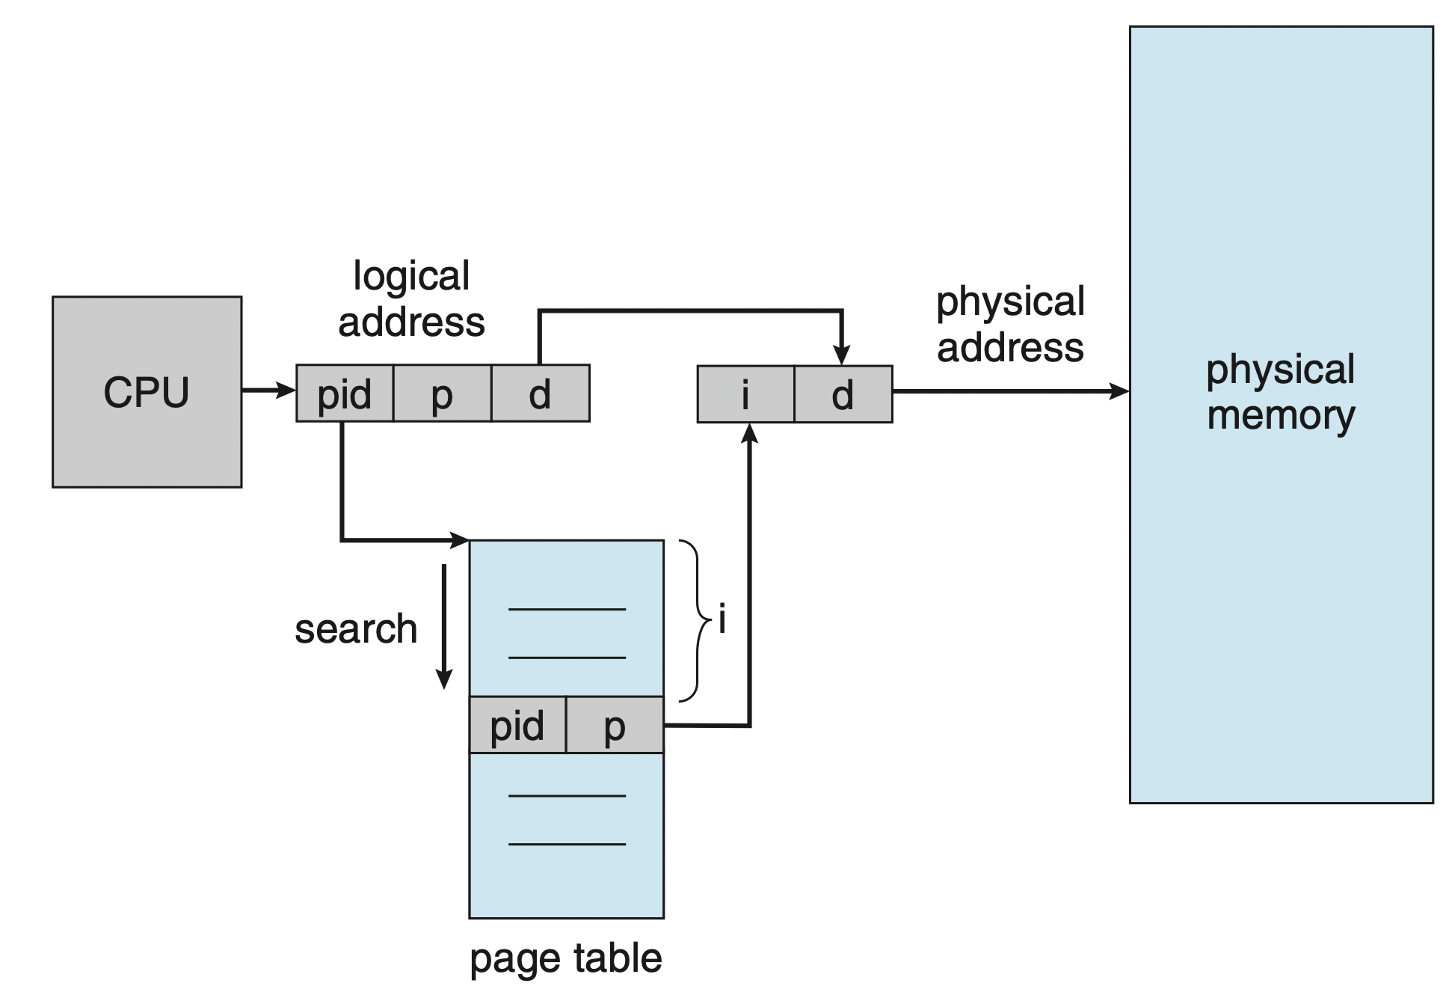
Out-dated: Inverted Page Table
Issue 1:Systems consume large memory space to store multi-level page tables.
Idea: Single-level page table, PTE = <process-id, page-number, offset>.
<process-id, page-number> equals to the function of multi-level tables.
If a match is found, <process-id, page-number> = i, get physical page (frame) by <I, offset>. (Sorted by the physical addresses)
Disadvantages:
Shall walk through the whole table if there is no matched.
One physical page cannot have two shared virtual addresses.
Ref: Operating System Concepts (Tenth Edition)

Slide 36
Huge Page Management
CPU
MMU
Regular TLB (4KB)
Huge TLB (2MB)
VA 0
PA 3
VA10-522
PA 80-592
Challenge of using 4KB page size.
TLB_Reach (TLB_Size X Page_Size): The amount of memory accessible from the TLB. (High TLB Misses)
Page Table Walk: Up to 4 DRAM accesses for translating a virtual address.
Huge Page: Large contiguous (both virtual and physical) memory chunk.
Libhugetlbfs: A library that can back application text, data, malloc() and shared memory with huge pages.
Transparent Huge Page (THP)
Huge Page Promotion
Huge Page Demotion
VA 1
PA 8
VA 2
PA 1
Virtual Address (Tag) = VA
Physical Address = PA
Page Table Walk
Pages in Swap Area
(Page Fault)
Operating System
Context Switching
+
Memory Management
Huge Page Management
Main Memory (e.g., DRAM)
…
Regular Pages
…
Huge Page
PML4T
PDPT
PDT
PT
Huge Page Promotion
Swap Area (e.g., Storage Devices)
Regular Pages
…
…
…

